Slide 1
Evaluating the Emotional Intelligence of Large Language Models
Sahand Sabour, Siyang Liu, Zheyuan Zhang, June M. Liu, Jinfeng Zhou, Alvionna S. Sunaryo, Tatia M.C. Lee, Rada Mihalcea, Minlie Huang · Tsinghua Univ. / Univ. of Michigan / HKU
RESEARCH PAPER
?
Motivation: Why EI Evaluation Matters
!
Problems with Prior Benchmarks & Why EmoBench
EI enables recognizing, understanding, and managing thoughts and feelings — shaping relationships, decisions, and well-being.
1
Focus narrowly on emotion recognition — neglect emotion regulation & thought facilitation.
Emotionally intelligent systems are perceived as more trustworthy and engaging.
2
Built from existing datasets with frequent patterns, explicit cues, and annotation errors → unreliable evaluation.
Critical for education, customer service, and mental-health support applications.
3
EmoBench was proposed as a theory-based benchmark requiring genuine reasoning, not pattern matching.
KEY TAKEAWAY: Prior EI benchmarks tested pattern-based recognition; EmoBench demands genuine emotional reasoning.
1
Notes:
Good [morning/afternoon]. This work is EmoBench, ACL 2024, which I am presenting as part of my internship under Prof. Brejesh Lall. Emotional intelligence matters for LLMs because it affects trust, engagement, and usefulness in applications like mental-health support. Existing benchmarks only tested pattern-based emotion recognition and inherited errors from repurposed datasets, which motivated the authors to design a harder, theory-grounded benchmark — EmoBench.

Slide 2
The EmoBench Framework
A theory-based, comprehensive definition of Machine Emotional Intelligence
RESEARCH PAPER
Machine EI = accurately understand emotions and appropriately apply that understanding to manage emotions and facilitate thought.
Paper's Evaluation Pipeline
Dataset
EU
Emotional
Understanding
EA
Emotional
Application
Prompt
Identify emotions & their causes in complex, multi-person scenarios.
Recommend the most effective response/action in an emotional dilemma.
LLM
Prediction
400
2
121
Hand-crafted MCQs
Languages: EN + ZH
Base scenarios
Evaluation
Grounded in Salovey & Mayer, Goleman, Schuller & Schuller, and MacCann & Roberts.
Accuracy
KEY TAKEAWAY: EmoBench formalizes Machine EI into two testable tasks — Understanding (EU) and Application (EA).
2
Notes:
EmoBench defines two complementary tasks: Emotional Understanding, which requires identifying emotions and their causes, and Emotional Application, which requires choosing the most effective response to an emotional dilemma. The benchmark has 400 hand-crafted MCQs across 121 scenarios in English and Chinese, grounded in psychological theory. Every question flows through the same pipeline: dataset scenario, prompt construction, LLM inference, prediction parsing, and accuracy scoring.

Slide 3
Dataset & Benchmark Design
Emotional Understanding taxonomy — four main categories (Figures 3 & 4, paper)
RESEARCH PAPER
Complex Emotions
Personal Beliefs & Experiences
Emotional Cues
Perspective Taking
Emotion Transition
Cultural Value
Vocal Cues
Faux Pas
Mixture of Emotions
Sentimental Value
Visual Cues
Strange Story
Unexpected Outcome
Persona
False Belief
121 scenarios (1–3 individuals) → 200 Emotional Understanding MCQs + 200 Emotional Application MCQs = 400 total
EmoBench evaluates implication and reasoning — not surface-level pattern matching — going beyond simple emotion recognition.
KEY TAKEAWAY: Each EU category (CE, PBE, EC, PT) probes a distinct reasoning skill beyond pattern-based recognition.
3
Notes:
The Emotional Understanding taxonomy, shown in Figures 3 and 4 of the paper, organizes questions into four main categories — Complex Emotions, Personal Beliefs and Experiences, Emotional Cues, and Perspective Taking — each with sub-categories such as faux pas or false belief. In total, 121 hand-crafted scenarios generate 200 EU MCQs, complemented by 200 EA MCQs, for 400 questions overall, all designed to require inference over implied information.

Slide 4
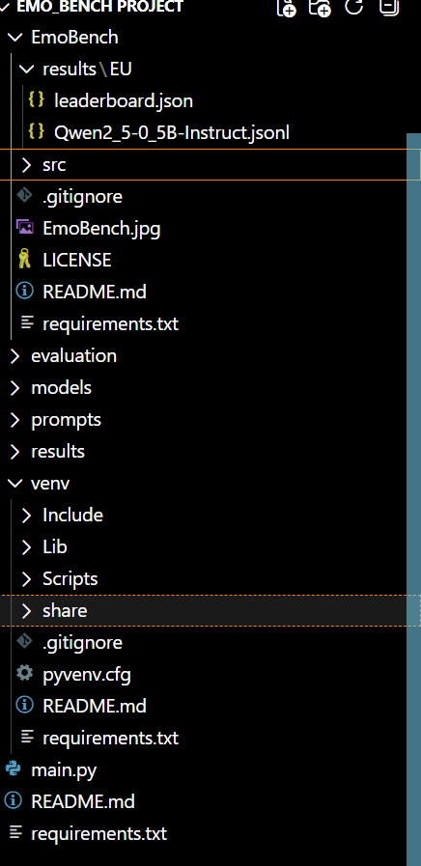
Repository Implementation & Evaluation Pipeline
Implementation Evidence
How we reproduced the EmoBench benchmark end-to-end
OUR IMPLEMENTATION
Repository Flow
Model Used
Dataset (EU.jsonl)
Qwen/Qwen2.5-0.5B-Instruct
main.py
Open-source & Hugging Face compatible
Lightweight, CPU-runnable, easy to reproduce
data.py
Well-suited for controlled benchmark evaluation
Role of Each File
model.py
main.py
Qwen2.5-0.5B-Instruct
Orchestrates the run — parses CLI args, wires data → model → evaluation.
data.py
Prediction
Loads EU/EA .jsonl scenarios and builds prompt-ready MCQs.
model.py
Evaluation
Wraps the HF model/tokenizer; handles generation & answer parsing.
leaderboard.json
evaluation.py
Scores predictions per category and writes leaderboard.json.
$ python src/main.py --model_type HF --model_path Qwen/Qwen2.5-0.5B-Instruct --lang en --task EU --device -1
KEY TAKEAWAY: Qwen2.5-0.5B-Instruct was chosen for fast, fully reproducible CPU-only evaluation of the EmoBench pipeline.
4
Notes:
For our reproduction, we built a lightweight pipeline: main.py orchestrates the run, data.py loads EU.jsonl and formats MCQ prompts, and model.py wraps the Hugging Face Qwen2.5-0.5B-Instruct model for inference. We chose this model because it is open-source, Hugging Face compatible, lightweight, and runs entirely on CPU, making it easy to reproduce without GPU access. The single command shown here runs the full Emotional Understanding evaluation and produces leaderboard.json.

Slide 5
Results
Paper-reported accuracy (%) vs. our own reproduction on Emotional Understanding
RESEARCH PAPER
OUR EXPERIMENTAL RESULTS
English-language results (Base/zero-shot); Chinese trends follow a similar pattern — see paper Tables 1–2.
MODEL Qwen2.5-0.5B-Instruct
TASK Emotional Understanding
LANGUAGE English
DEVICE CPU
DATASET 200 Samples
Model | EU (EN) | EA (EN)
Random* | 2.62 | 24.12
Majority* | 11.50 | 37.00
GPT-3.5 (Base) | 33.12 | 61.38
GPT-4 (Base) — best | 59.75 | 75.50
*Random/Majority baselines are language-invariant.
EU is harder than EA — GPT-4 scores ~60% (EU) vs ~76% (EA), since EU needs both emotion + cause.
★
Perspective Taking is the hardest EU category (GPT-4: 50.37% EN / 43.28% ZH) — a ToM-style skill.
8.50%
Output files: leaderboard.json · predictions_EU_en.jsonl
★
Overall Accuracy
Human evaluators outperform every LLM on both tasks (Fig. 5); GPT-4 is closest but still trails top humans.
★
KEY TAKEAWAY: Our lightweight CPU run (8.50% overall) sits far below GPT-4, consistent with the paper's model-scaling trend.
5
Notes:
On the left is the paper's reported accuracy for reference — GPT-4 leads at roughly 60% on EU and 76% on EA, with humans still ahead of every model. On the right are our own results: running Qwen2.5-0.5B-Instruct on the 200-sample English EU subset on CPU gave an overall accuracy of 8.50%, with Perspective Taking and Complex Emotions the weakest categories. This is expected given the model's very small 0.5B parameter count relative to the paper's baselines, and is consistent with the paper's finding that performance scales with model size.

Slide 6
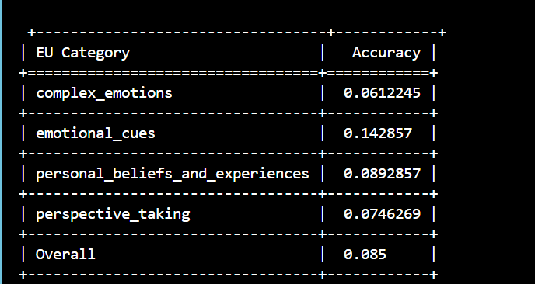
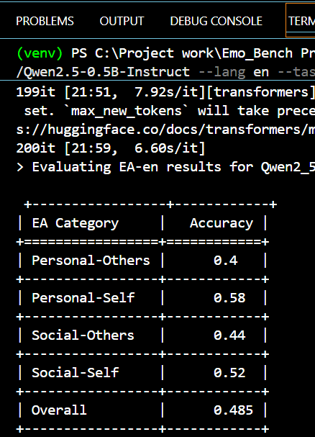
Appendix — Backup for Q&A
Our Output, execution command, model configuration
OUR OUTPUT
Model Configuration
Parameter | Value
Model | Qwen/Qwen2.5-0.5B-Instruct
Parameters | 0.5B
Backend | Hugging Face Transformers
Device | CPU (device = -1)
Task | Emotional Understanding (EU)
Language | English
Dataset size | 200 samples
Execution Command
python src/main.py --model_type HF \
--model_path Qwen/Qwen2.5-0.5B-Instruct \
--lang en --task EU --device -1
KEY TAKEAWAY: Everything needed to re-run this evaluation — command, config, and environment — is fully reproducible on CPU.
7
Notes:
This backup slide is for reference during Q&A. It shows the exact repository layout, the single command used to reproduce our run, the model configuration, and the CPU-only environment — Python 3.10 with Hugging Face Transformers and PyTorch — so the full evaluation can be reproduced by anyone without GPU access.

Slide 7
Conclusion
Paper contributions, our implementation contribution, limitations, and future work
●
Research Contributions
Paper
●
Our Contribution
Implementation
First comprehensive EI benchmark (EU + EA)
Implemented the EmoBench repository end-to-end
Psychology-inspired evaluation design
Integrated HF Qwen2.5-0.5B-Instruct on CPU
Human vs. LLM performance comparison
Executed the Emotional Understanding benchmark
Strong foundation for future EI research
Generated predictions, leaderboard & accuracy metrics
●
Limitations
Paper + Ours
●
Future Work
Next Steps
Text-only benchmark (single modality)
Larger, multilingual datasets
English & Chinese only
Multi-modal emotional intelligence
Limited dataset scale (400 MCQs)
Compare more open-source LLMs
Our run used a small 0.5B model on a 200-sample subset
GPU-based evaluation for larger models
Thank You
KEY TAKEAWAY: The paper builds the benchmark; our contribution reproduces and evaluates it end-to-end on a lightweight open-source LLM.
6
Notes:
To summarize: the paper's core contribution is the first comprehensive, psychology-grounded EI benchmark with a human-versus-LLM comparison. My contribution was implementing and running the EmoBench repository myself, integrating a Hugging Face model, and generating my own leaderboard and accuracy metrics. Limitations include the text-only, bilingual scope of the paper and the small model and subset used in my own run. Future work includes multi-modal EI, larger multilingual data, and GPU-based evaluation of bigger open-source models. Thank you.

